Slide 1



JAVA 8 workshop
Chaim Turkel

Slide 2

Agenda
Introduction to Java 8
Default methods
Functional Programing
Lambdas
methods as references
Functional Interfaces
FP with streams
Optionals
Extras (Date/Time and bye-bye PermGen).

Slide 3

Introduction to java 8
From Java 1.5, there weren't any major changes with the Java language.
Trends like “functional programming” and “lambda expressions” became more common and the Java’s “ignoring strategy” was proven wrong.
Scala grew more successful and started to challenge Java.
The language must go on.

Slide 4
Introduction to java 8
What is new?
Default interface methods implementation.
New Date time API.
New JS engine.
Lambda expressions support.
Method references.
New collections streams API (including built-in parallel processing).
Optionals
JVM inhancements (PermGen removed, and small VM).

Slide 5
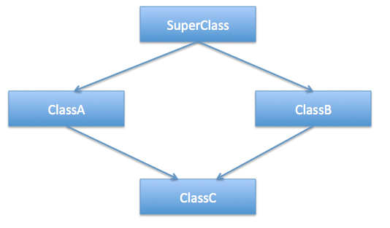
Default Methods

Slide 6
Default Methods
Until java 8, multiple inheritance was not supported.
Why doesn’t Java support multiple inheritance?
For the sake of simplicity
Complicates the design
Constructor chaining
The diamond problem
A
()F
()override F
B
C
()Inherit F
D
? ()F

Slide 7
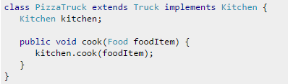
Default Methods
Until java 8, multiple inheritance was not supported.
Why doesn’t Java support multiple inheritance?
For the sake of simplicity
Complicates the design
Constructor chaining
The diamond problem
What is the solution to multiple inheritance?
Delegation with multiple interfaces

Slide 8
Default Methods
By using interfaces, Java allowed some sort of multiple inheritance.
Interfaces are just a bunch of declarations – they does not allow any implementation of a default method body.

Slide 9
Default Methods
By using interfaces, Java allowed some sort of multiple inheritance.
Interfaces are just a bunch of declarations – they does not allow any implementation of a default method body.
This solves the diamond problem - ambiguity methods implementations.

Slide 10
Default Methods
Java 8 has a new feature: Interfaces with default methods.

Slide 11
Default Methods
Java 8 has a new feature: Interfaces with default methods.
public interface A {
public default void doSomething() {
System.out.println("default implementation");
}
}

Slide 12
Default Methods
Java 8 has a new feature: Interfaces with default methods.
public interface A {
public default void doSomething() {
System.out.println("default implementation");
}
}
Using the word default we can declare a default implementation That will be chosen if the implementing class did not provide an implementation of it’s own

Slide 13
Default Methods
Java 8 has a new feature: Interfaces with default methods.
public interface A {
public default void doSomething() {
System.out.println("default implementation");
}
}
public class Student implements A {
}

Slide 14
Default Methods
Java 8 has a new feature: Interfaces with default methods.
public interface A {
public default void doSomething() {
System.out.println("default implementation");
}
}
public class Student implements A {
}
public static void main(String[] args) {
Student student = new Student();
student.doSomething();
}

Slide 15
Default Methods
Java 8 has a new feature: Interfaces with default methods.
public interface A {
public default void doSomething() {
System.out.println("default implementation");
}
}
public class Student implements A {
}
public static void main(String[] args) {
Student student = new Student();
student.doSomething();
}
()No implementation of A.doSomething

Slide 16
Default Methods
An interface method with a default implementation is called: Defender-method or Virtual extension method.

Slide 17
Default Methods
An interface method with a default implementation is called: Defender-method or Virtual extension method.
public interface A {
public default void doSomething() {
System.out.println("default implementation");
}
public void doSomethingElse();
}

Slide 18
Default Methods
An interface method with a default implementation is called: Defender-method or Virtual extension method.
public interface A {
public default void doSomething() {
System.out.println("default implementation");
}
public void doSomethingElse();
}
Defender method

Slide 19
Default Methods
An interface method with a default implementation is called: Defender-method or Virtual extension method.
public interface A {
public default void doSomething() {
System.out.println("default implementation");
}
public void doSomethingElse();
}
public class Student implements A {
@Override
public void doSomethingElse() {
System.out.println("Something else");
}
}

Slide 20
Default Methods
So what about the diamond problem and multiple inheritance:

Slide 21
Default Methods
So what about the diamond problem and multiple inheritance:
The chosen implementation will be the closest one in the hierarchy level.

Slide 22
Default Methods
So what about the diamond problem and multiple inheritance:
The chosen implementation will be the closest one in the hierarchy level.
A
()F
C
()override F
()override F
B
D
E
()F() == B.F

Slide 23
Default Methods
What if two implementations are at the same level?

Slide 24
Default Methods
What if two implementations are at the same level?
public interface A {
public default void doSomething() {
System.out.println("A: default implementation");
}
}
public interface B {
public default void doSomething() {
System.out.println(“B: default implementation");
}
}
public class Student implements A, B {
}

Slide 25
Default Methods
What if two implementations are at the same level?
public interface A {
public default void doSomething() {
System.out.println("A: default implementation");
}
}
public interface B {
public default void doSomething() {
System.out.println(“B: default implementation");
}
}
public class Student implements A, B {
}
Which will be chosen?

Slide 26
Default Methods
What if two implementations are at the same level?
public class Student implements A, B {
}
None! We will have to provide an implementation for the ambiguous method in the implementing class.

Slide 27
Default Methods
What if two implementations are at the same level?
public class Student implements A, B {
}
None! We will have to provide an implementation for the ambiguous method in the implementing class:
public class Student implements A, B {
@Override
public void doSomething() {
}
}
public class Student implements A, B {
@Override
public void doSomething() {
A.super.doSomething();
}
}

Slide 28
Default Methods
Why do we need default methods?! We managed just fine without them for a long time.

Slide 29
Default Methods
Why do we need default methods?! We managed just fine without them for a long time.
Interfaces are coupled with implementing classes. It is impossible to add a method to an interface without harming all it’s implementers.
Java 8 presents a lot of new functionality, especially with collections and lambda expressions. In order to provide backward compatibility – default methods are needed.

Slide 30
Default Methods
Interfaces with default methods vs abstract class:
Default methods cannot be constructors
Interfaces with Default methods cannot have members
Default methods cannot hold an object’s state.
Default methods are mostly there for backward compatibility.

Slide 31

Functional Programming

Slide 32
Functional Programming
Not new, 1930 – lambda calculus (academic world)
Functional programming is an ongoing trend in the programming world, that cannot be ignored (haskell, erlang, list, scheme, groovy, F#, scala).
In the Java world, only primitives can exist outside an object scope.
But FP is all about functions.

Slide 33
Why Functional Programming
Programming Paradigms: Function, Structural, Object Oriented.
Function base blocks:
No State
Immutable
No Side effect
Main Advantage:
True simultaneous execution
Less resource leaks

Slide 34
Functional Programming
Java 8 presents some new ways to overcome these problems (at least partially) with new syntax and new capabilities:

Slide 35
Functional Programming
Java 8 presents some new ways to overcome these problems (at least partially) with new syntax and new capabilities:
Lambda expressions
Method references
Streams

Slide 36

Functional Programming

Slide 37
Functional Programming
Higher order functions: Mathematically: Y = F(X)
inventory.sort( (x,y) -> x.getWeight() - y.getWeight() );

Slide 38
Functional Programming
Higher order functions: Mathematically: Y = F(X)
inventory.sort( (x,y) -> x.getWeight() - y.getWeight() );
F

Slide 39
Functional Programming
Higher order functions: Mathematically: Y = F(X)
inventory.sort( (x,y) -> x.getWeight() - y.getWeight() );
F
X

Slide 40
Functional Programming
Higher order functions: Mathematically: Y = F(X)
inventory.sort( (x,y) -> x.getWeight() - y.getWeight() );
Sort() is a higher order function

Slide 41
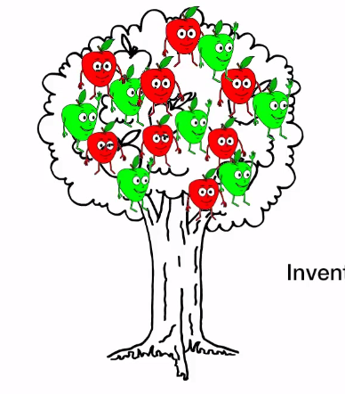
FP - Lambdas
Our inventory = List of Apples
public class Apple {
private String color;
private int weight;
public String getColor() {...}
public void setColor(String color) {...}
public int getWeight() {...}
public void setWeight(int weight) {...}
}

Slide 42

FP - Lambdas
Our inventory = List of Apples

Slide 43
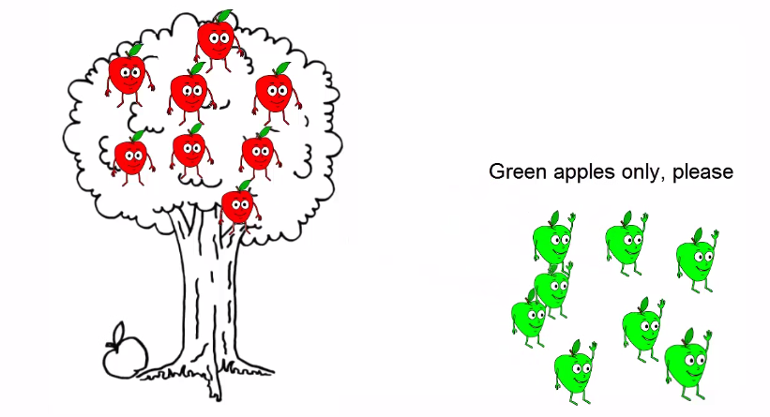

FP - Lambdas
Green apples only please:

Slide 44
FP - Lambdas
Green apples only please:
public static List<Apple> filterGreenApples(List<Apple> inventory) {
List<Apple> result = new ArrayList<>();
for (Apple apple : inventory) {
if (apple.getColor().equals("green")) {
result.add(apple);
}
}
return result;
}

Slide 45
FP - Lambdas
Green apples only please:
public static List<Apple> filterGreenApples(List<Apple> inventory) {
List<Apple> result = new ArrayList<>();
for (Apple apple : inventory) {
if (apple.getColor().equals("green")) {
result.add(apple);
}
}
return result;
}
Start empty add green apples one by one

Slide 46
FP - Lambdas
Green apples only please:
public static List<Apple> filterGreenApples(List<Apple> inventory) {
List<Apple> result = new ArrayList<>();
for (Apple apple : inventory) {
if (apple.getColor().equals("green")) {
result.add(apple);
}
}
return result;
}
Select only green apples

Slide 47

FP - Lambdas
Now, heavy apples please:

Slide 48
FP - Lambdas
Now, heavy apples please:
public static List<Apple> filterHeavyApples(List<Apple> inventory) {
List<Apple> result = new ArrayList<>();
for (Apple apple : inventory) {
if (apple.getWeight() > 150) {
result.add(apple);
}
}
return result;
}

Slide 49
FP - Lambdas
Now, heavy apples please:
public static List<Apple> filterHeavyApples(List<Apple> inventory) {
List<Apple> result = new ArrayList<>();
for (Apple apple : inventory) {
if (apple.getWeight() > 150) {
result.add(apple);
}
}
return result;
}
Copy&paste And only change the predicate

Slide 50
FP - Lambdas
What is the difference?!
public static List<Apple> filterGreenApples(List<Apple> inventory) {
List<Apple> result = new ArrayList<>();
for (Apple apple : inventory) {
if (apple.getColor().equals("green")) {
result.add(apple);
}
}
return result;
}
public static List<Apple> filterHeavyApples(List<Apple> inventory) {
List<Apple> result = new ArrayList<>();
for (Apple apple : inventory) {
if (apple.getWeight() > 150) {
result.add(apple);
}
}
return result;
}

Slide 51
FP - Lambdas
What is the difference?!
public static List<Apple> filterGreenApples(List<Apple> inventory) {
List<Apple> result = new ArrayList<>();
for (Apple apple : inventory) {
if (apple.getColor().equals("green")) {
result.add(apple);
}
}
return result;
}
public static List<Apple> filterHeavyApples(List<Apple> inventory) {
List<Apple> result = new ArrayList<>();
for (Apple apple : inventory) {
if (apple.getWeight() > 150) {
result.add(apple);
}
}
return result;
}

Slide 52
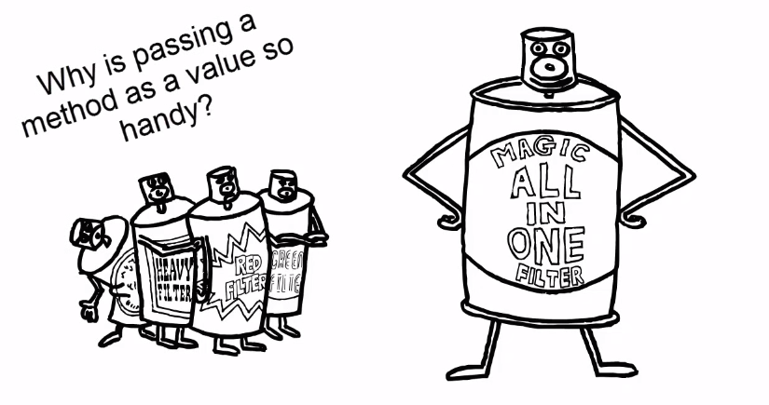
FP - Lambdas
Why is passing a method as a value is so handy?

Slide 53
FP - Lambdas
Why is passing a method as a value is so handy?
public static List<Apple> filterApples(List<Apple> inventory, Predicate<Apple> predicate) {
List<Apple> result = new ArrayList<>();
for (Apple apple: inventory) {
if (predicate.test(apple)) {
result.add(apple);
}
}
return result;
}
predicate

Slide 54
FP - Lambdas
Why is passing a method as a value is so handy?
public static List<Apple> filterApples(List<Apple> inventory, Predicate<Apple> predicate) {
List<Apple> result = new ArrayList<>();
for (Apple apple: inventory) {
if (predicate.test(apple)) {
result.add(apple);
}
}
return result;
}
predicate
Apple.getWeight > 150
Apple.getColor.equals(“green”)
Heavy Apples
Green Apples

Slide 55
FP - Lambdas
Nice and neat…
public static List<Apple> filterApples(List<Apple> inventory, Predicate<Apple> predicate) {
List<Apple> result = new ArrayList<>();
for (Apple apple: inventory) {
if (predicate.test(apple)) {
result.add(apple);
}
}
return result;
}
predicate
But what about the client (invoker) ?

Slide 56
FP - Lambdas
The client… Yuck ☹
List<Apple> greenApples = filterApples(inventory, new Predicate<Apple>() {
@Override
public boolean test(Apple a) {
return a.getColor().equals("green");
}
});
predicate

Slide 57
FP - Lambdas
The client… Yuck ☹
List<Apple> greenApples = filterApples(inventory, new Predicate<Apple>() {
@Override
public boolean test(Apple a) {
return a.getColor().equals("green");
}
});
predicate
Anonymous class = A lot of noise

Slide 58

FP - Lambdas
Lambdas help eliminate verbosity.
Using lambdas we provide the implementation with only “the important code”
Flip the direction of the code – no more loops

Slide 59
FP - Lambdas
Using lambda:
filterApples(inventory, (Apple a) -> {return a.getColor().equals("green")} );
predicate

Slide 60
FP - Lambdas
Using lambda:
filterApples(inventory, (Apple a) -> {return a.getColor().equals("green")} );
predicate
{("Apple a) -> {return a.getColor().equals("green)
Arguments
Function implementation body

Slide 61
FP - Lambdas
Using lambda:
filterApples(inventory, (a) -> {return a.getColor().equals("green")} );
predicate
(a) -> {return a.getColor().equals("green")
Apple type can be automatically inferred

Slide 62
FP - Lambdas
Using lambda:
filterApples(inventory, (a) -> a.getColor().equals("green") );
predicate
(a) -> a.getColor().equals("green")
One line does not need curly-braces and/or return statement

Slide 63
FP - Lambdas
Using lambda:
filterApples(inventory, a -> a.getColor().equals("green") );
predicate
(a -> a.getColor().equals("green")
One argument does not need parentheses.

Slide 64
FP - Lambdas
Using lambda – the difference:
List<Apple> greenApples = filterApples(inventory, a -> a.getColor().equals("green") );
List<Apple> greenApples = filterApples(inventory, new Predicate<Apple>() {
@Override
public boolean test(Apple a) {
return a.getColor().equals("green");
}
});
predicate

Slide 65
FP - Lambdas
Using lambda – the difference:
List<Apple> greenApples = filterApples(inventory, a -> a.getColor().equals("green") );
List<Apple> greenApples = filterApples(inventory, new Predicate<Apple>() {
@Override
public boolean test(Apple a) {
return a.getColor().equals("green");
}
});
predicate
This is a simple case – lambdas can reduce a lot of verbosity!

Slide 66
FP - Lambdas
Examples:
Lambda function to return the number 999:
() -> 999

Slide 67
FP - Lambdas
Examples:
Lambda function to return the number 999:
() -> 999
No parameters

Slide 68
FP - Lambdas
Examples:
Lambda function to return the number 999:
() -> 999
Lambda function to print a “This is Lambda” () -> System.out.println("This is lambda");
Lambda function to print a given string:
(String str) -> { System.out.println(str); }

Slide 69
FP - Lambdas
Examples:
Lambda function to sum two numbers:
(int a, int b) -> { return a + b; }
Lambda function to compare two Students
Comparator<Student> cmp = (x,y) -> (x.getId() - y.getId());

Slide 70
FP - Lambdas
Lambda syntax rules:
Lambda expression can have none or some arguments.
Type of an argument can be specifically declared or it can be automatically inferred from the context.
If there is only one statement in the method body, curly brackets and return statement are not mandatory.
Return type will be inferred from the context.

Slide 71
FP - Method references
Lambdas are great syntax improvement.
But like anonymous classes, they can be used in only one context.

Slide 72
FP - Method references
Lambdas are great syntax improvement.
But like anonymous classes, they can be used in only one context.
What if we would like to use the same implementation in several different places?
We would like to pass a reference to a method as a parameter to a function.

Slide 73
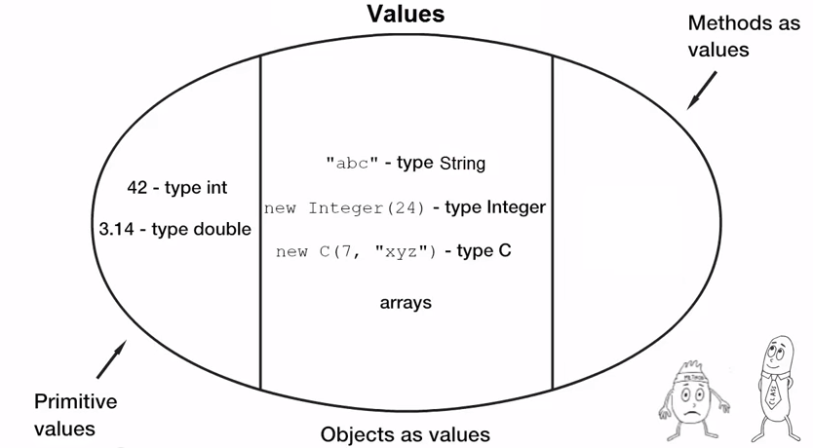
FP - Method references
Java 7:
predicate

Slide 74
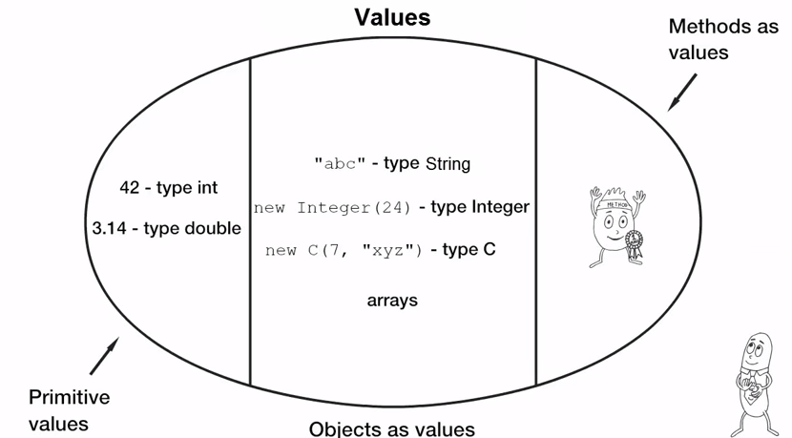
FP - Method references
Java 8:
predicate

Slide 75
FP - Method references
Apple isGreen method:
public class Apple {
private String color;
private int weight;
public boolean isGreen() {
return color.equals(“green”);
}
}
List<Apple> greenApples = filterApples(inventory, apple::isGreen );
predicate

Slide 76
FP - Method references
Apple isGreen method:
public class Apple {
private String color;
private int weight;
public boolean isGreen() {
return color.equals(“green”);
}
}
List<Apple> greenApples = filterApples(inventory, apple::isGreen );
predicate
Reference to isGreen method in Apple class

Slide 77
FP - Method references
Reference to a static method:
Apple::isGreen
Reference to an instance method: apple::isGreen
Reference to a constructor:
Apple::new

Slide 78
Functional Interface
So, How does it work?

Slide 79
Functional Interface
So, How does it work?
Java 8 introduces the “Functional Interface”.
This is an interface with only one abstract method.
This is called SAM (Single Abstract Method).

Slide 80
Functional Interface
So, How does it work?
Java 8 introduces the “Functional Interface”.
This is an interface with only one abstract method.
This is called SAM (Single Abstract Method).
The abstract method implementation is received later by lambda or by a reference to a method.

Slide 81
Functional Interface
Java 8 introduces the annotation @FunctionalInterface
@FunctionalInterface
This is a compile time annotation which will cause a compilation error in case of more than one abstract methods.

Slide 82
Functional Interface
Java 8 introduces the annotation @FunctionalInterface
@FunctionalInterface
This is a compile time annotation which will cause a compilation error in case of more than one abstract methods.
A functional interface can have more than one method as long as only one is abstract (others can have default implementations).

Slide 83
Functional Interface
Predicate is a functional interface
@FunctionalInterface
public interface Predicate<T> {
boolean test(T t);
default Predicate<T> negate() {
return (t) -> !test(t);
}
default Predicate<T> or(Predicate<? super T> other) {
return (t) -> test(t) || other.test(t);
}
default Predicate<T> and(Predicate<? super T> other){
return (t) -> test(t) && other.test(t);
}
}

Slide 84
Functional Interface
Predicate is a functional interface
@FunctionalInterface
public interface Predicate<T> {
boolean test(T t);
default Predicate<T> negate() {
return (t) -> !test(t);
}
default Predicate<T> or(Predicate<? super T> other) {
return (t) -> test(t) && other.test(t);
}
default Predicate<T> and(Predicate<? super T> other){
return (t) -> test(t) && other.test(t);
}
}
Single Abstract Method

Slide 85
Functional Interface
In fact, these are functional interfaces too:
interface Comparator<T> { boolean compare(T x, T y); } (int x, int y) → x - y ;
interface FileFilter { boolean accept(File x); } f → f.isDirectory()
interface Runnable { void run(); } () → someCode();
interface ActionListener{ void actionPerformed(ActionEvent ae); } ae -> log.debug(“Got it!”);

Slide 86
Functional Interface
Java 8 presents these new functional interfaces:
Predicate<T>: boolean test(T t); Determine if the input of type T matches some criteria
Consumer<T>: void accept(T t); Accept a single input argument of type T (return nothing)
Supplier<T>: T get(); A factory that return a new instance or a pre-created one
Function<T, R> R apply(T t); Apply a function to the input type T, generating a result of type R

Slide 87
Summary
List<Integer> values = Arrays.asList(1,2,3,4,5,6); //version 1 - loop for (int i=0; i<values.size(); i++){ System.out.println(values.get(i)); } //version 2 – for each for (int i: values){ System.out.println(values.get(i)); } //version 3 – anonymous class values.forEach(new Consumer<Integer>() { @Override public void accept(Integer integer) { System.out.println(values.get(i)); } }); //what is a function: . method name 2. method parameter 3. method return type 4. method body //version 4 //we have the body, and parameter //return type will be figured out, and name is unnecessary values.forEach((Integer value) -> System.out.println(value)); //version 5 //if the collection is of integers, why do we need to specify the integer? values.forEach((value) -> System.out.println(value)); //version 6 //this code just takes the parameter and passed it to another method //so we will use a method reference values.forEach(System.out::println);

Slide 88
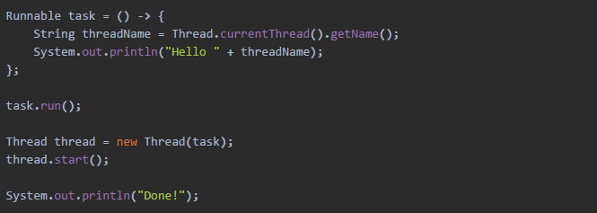
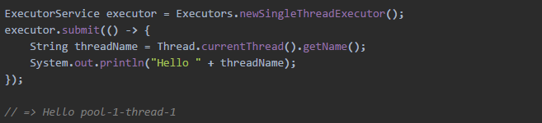
Useful example

Slide 89

FP with Streams

Slide 90

FP with Streams
Dishes:
public class Dish {
. . .
String getName() {...}
boolean isVegeterian() {...}
int getCalories() {...}
Type getType() {...}
List<String> getNickNames() {...}
CaloricLevel getCaloricLevel() {...}
}

Slide 91
FP with Streams
Let’s get 3 fat dishes:
List<String> fatDishes = new ArrayList<>();
int count = 0;
for (Dish dish : menu) {
if (count > 3)
break;
if (dish.getCalories() > 300){
count++;
fatDishes.add(dish.getName());
}
}

Slide 92
FP with Streams
Let’s get 3 fat dishes:
List<String> fatDishes = new ArrayList<>();
int count = 0;
for (Dish dish : menu) {
if (count > 3)
break;
if (dish.getCalories() > 300) {
count++;
fatDishes.add(dish.getName());
}
}
Client code controls the iteration it counts, loops, filters, etc..
Must be serial We cannot run this code parallel without massive changes.
This is not thread-safe Business logic is mutable
This is too imperative

Slide 93
FP with Streams
Let’s get 3 fat dishes:
List<String> fatDishes = new ArrayList<>();
int count = 0;
for (Dish dish : menu) {
if (count > 3)
break;
if (dish.getCalories() > 300) {
count++;
fatDishes.add(dish.getName());
}
}
Client code controls the iteration it counts, loops, filters, etc..
Must be serial We cannot run this code parallel without massive changes.
This is not thread-safe Business logic is mutable
This is too imperative
External iteration

Slide 94
FP with Streams
Using Stream we can do this the “functional way”
Instead of imperatively tell the computer how to do something
We‘ll tell it declaratively what should be done.
List<Dish> menu = new ArrayList<>();
List<String> fatDishes = menu.stream()
.filter(d -> d.getCalories() > 300)
.map(Dish::getName)
.limit(3)
.collect(toList());

Slide 95
FP with Streams
Using Stream we can do this the “functional way”
Instead of imperatively tell the computer how to do something
We‘ll tell it declaratively what should be done.
List<Dish> menu = new ArrayList<>();
List<String> fatDishes = menu.stream()
.filter(d -> d.getCalories() > 300)
.map(Dish::getName)
.limit(3)
.collect(toList());
Get all the dishes that fits the filter

Slide 96
FP with Streams
Using Stream we can do this the “functional way”
Instead of imperatively tell the computer how to do something
We‘ll tell it declaratively what should be done.
List<Dish> menu = new ArrayList<>();
List<String> fatDishes = menu.stream()
.filter(d -> d.getCalories() > 300)
.map(Dish::getName)
.limit(3)
.collect(toList());
Get all the dishes that fits the filter
Consider only the names

Slide 97
FP with Streams
Using Stream we can do this the “functional way”
Instead of imperatively tell the computer how to do something
We‘ll tell it declaratively what should be done.
List<Dish> menu = new ArrayList<>();
List<String> fatDishes = menu.stream()
.filter(d -> d.getCalories() > 300)
.map(Dish::getName)
.limit(3)
.collect(toList());
Get all the dishes that fits the filter
Consider only the names
Return 3 values only

Slide 98
FP with Streams
Using Stream we can do this the “functional way”
Instead of imperatively tell the computer how to do something
We‘ll tell it declaratively what should be done.
List<Dish> menu = new ArrayList<>();
List<String> fatDishes = menu.stream()
.filter(d -> d.getCalories() > 300)
.map(Dish::getName)
.limit(3)
.collect(toList());
Get all the dishes that fits the filter
Consider only the names
Return 3 values only
Gather result to a list

Slide 99
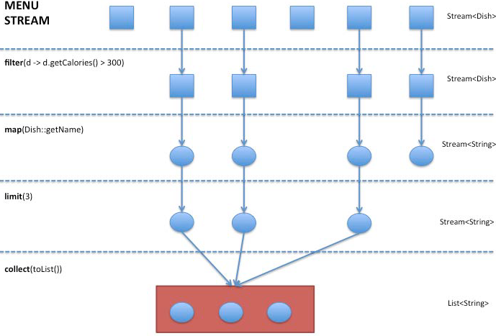
FP with Streams

Slide 100
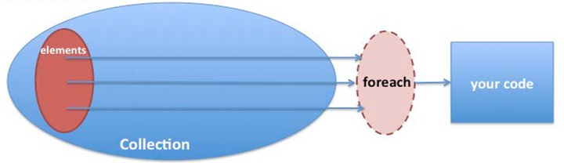
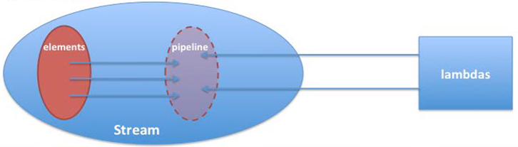
FP with Streams
Collection - External iteration
Stream - Internal Iteration

Slide 101
FP with Streams
Stream: A sequence of elements of a source that supports aggregate operations
Streams are not data-structures.
Their goal is to compute and aggregate.
They consume their data from I/O sources, Arrays and collections.
Support SQL like operations and some other commonly used functionality such as map, reduce, filter, collect, sort and more.
Streams are immutable – they cannot change the data. Therefore they are thread-safe.
Streams can run parallel (Several cores).
Streams uses pipelines and optimize the operations needed to minimum iterations.

Slide 102
FP with Streams
Creating streams:
IntStream.range(1, 100);
Stream.of("Java 8 ", "Lambdas");
File.list(Paths.get("some-folder"));
Files.lines(Paths.get("data.txt"));
myList.parallelStream();
Stream.iterate(new int[]{0, 1}, t -> new int[]{t[1], t[0]+t[1]})

Slide 103
FP with Streams
Streams high order functions - Map
<R> Stream<R> map (Function<? super T, ? extends R> mapper);
Apply the mapper function on each element of the stream. And generate a new stream of the output by gathering the results of the mapper function.

Slide 104
FP with Streams
Streams high order functions - Map
<R> Stream<R> map (Function<? super T, ? extends R> mapper);
Apply the mapper function on each element of the stream. And generate a new stream of the output by gathering the results of the mapper function.
Stream<String> fatDishes = menu.stream()
.map(Dish::getName)

Slide 105
FP with Streams
Streams high order functions - Map
<R> Stream<R> map (Function<? super T, ? extends R> mapper);
Apply the mapper function on each element of the stream. And generate a new stream of the output by gathering the results of the mapper function.
Stream<String> fatDishes = menu.stream()
.map(Dish::getName)
Convert a stream of Dishes to names stream

Slide 106
FP with Streams
Streams high order functions - Map
Collection of Dishes
Dish
Dish
Dish
Dish
Map
Collection of Strings
Dish Name
Dish Name
Dish Name
Dish Name

Slide 107
FP with Streams
Streams high order functions - Flat Map
<R> Stream<R> faltMap( Function<? super T, ? extends Stream<? extends R>> mapper);
Apply the mapper function on each element of the stream. And generate a new stream of the output by gathering the result of the inner streams content.

Slide 108
FP with Streams
Streams high order functions - Flat Map
<R> Stream<R> faltMap( Function<? super T, ? extends Stream<? extends R>> mapper);
Apply the mapper function on each element of the stream. And generate a new stream of the output by gathering the result of the inner streams content.
menu.stream().flatMap(d -> d.getNickNames().stream());

Slide 109
FP with Streams
Streams high order functions - Flat Map
<R> Stream<R> faltMap( Function<? super T, ? extends Stream<? extends R>> mapper);
Apply the mapper function on each element of the stream. And generate a new stream of the output by gathering the result of the inner streams content.
menu.stream().flatMap(d -> d.getNickNames().stream());
Convert a stream of streams of the Dishes nicknames to names stream

Slide 110
FP with Streams
Streams high order functions - Reduce
Optional<T> reduce(BinaryOperator<T> accumulator);
Reduction of all the elements of the stream to one single value.
menu.stream().map((d) -> d.getCalories()) .reduce((result, cals) -> result += cals);

Slide 111
FP with Streams
Streams high order functions - Reduce
Optional<T> reduce(BinaryOperator<T> accumulator);
Reduction of all the elements of the stream to one single value.
menu.stream().map((d) -> d.getCalories()) .reduce((result, cals) -> result += cals);
Sum all calories of the menu

Slide 112
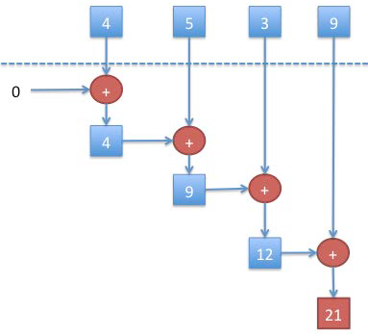
FP with Streams
Streams high order functions - Reduce

Slide 113
FP with Streams
Streams high order functions - Filter
Stream<T> filter(Predicate<? super T> predicate)
Gather a stream of all the elements that match a given predicate.
menu.stream().filter(d -> d.getCalories() > 300);

Slide 114
FP with Streams
Streams high order functions - Filter
Stream<T> filter(Predicate<? super T> predicate)
Gather a stream of all the elements that match a given predicate.
menu.stream().filter(d -> d.getCalories() > 300);
Get a stream of dishes that has more than 300 calories

Slide 115
FP with Streams
Streams high order functions - forEach
void forEach(Consumer<? super T> action);
Apply the action for any member of the stream.
menu.stream().forEach(d -> System.out.println(d.getName()));

Slide 116
FP with Streams
Streams high order functions - forEach
void forEach(Consumer<? super T> action);
Apply the action for any member of the stream.
menu.stream().forEach(d -> System.out.println(d.getName()));
Print all names of all the dishes

Slide 117
FP with Streams
Streams high order functions - more methods:
collect: Convert the final stream to something else using a given collector.
sorted: Returns a new Stream with all the elements sorted by a given comparator.
limit: Returns a new stream with only N elements of the current stream.
anyMatch: Returns true if there at least one element matching a given predicate.
allMatch: Returns true if all the element match a predicate.

Slide 118
FP with Streams
Streams high order functions - more methods:
count: Returns the number of elements in the stream.
distinct: Returns a new Stream with no duplications (using equals method).
skip: Returns a new Stream without the first N elements.
Min / max: Returns the minimum / maximum element using a provided comparator.
Concat: Return a new stream containing elements from two streams.

Slide 119
FP with Streams
Streams high order functions - Group dishes by type (imperative):
Map<Dish.Type, List<Dish>> groupDishesByTypeMap = new HashMap<>();
for (Dish dish : menu) {
final Type type = dish.getType();
List<Dish> dishesForType = groupDishesByTypeMap.get(type);
if(dishesForType == null) {
dishesForType = new ArrayList<>();
groupDishesByTypeMap.put(type, dishesForType);
}
dishesForType.add(dish);
}
return groupDishesByTypeMap;

Slide 120
FP with Streams
Streams high order functions - Group dishes by type (Declerative):
Map<Dish.Type, List<Dish>> groupDishesByTypeMap =
menu.stream().collect(Collectors.groupingBy(Dish::getType));

Slide 121
FP with Streams
Streams high order functions - Group dishes by type (Declerative):
Map<Dish.Type, List<Dish>> groupDishesByTypeMap =
menu.stream().collect(Collectors.groupingBy(Dish::getType));
Pre created static method

Slide 122
FP with Streams
Streams high order functions - examples
Stream lines of all files of “txt“ type
Files.list(Paths.get(“/filesLocation”))
.filter(p -> p.toString().endsWith(“txt”))
.flatMap(Files.lines(path, charset)
.map(this::parse);

Slide 123
FP with Streams
Streams high order functions - examples
Stream lines of all files of “txt“ type
Files.list(Paths.get(“/filesLocation”))
.filter(p -> p.toString().endsWith(“txt”))
.flatMap(Files.lines(path, charset)
.map(this::parse);
Files.list will generate a Stream of Pathes.
We want only “txt” files so we will use filter.

Slide 124
FP with Streams
Streams high order functions - examples
Stream lines of all files of “txt“ type
Files.list(Paths.get(“/filesLocation”))
.filter(p -> p.toString().endsWith(“txt”))
.flatMap(Files.lines(path, charset)
.map(this::parse);
Now we have a Stream of Paths which includes files.
But a file can also be considered as a stream of Strings.

Slide 125
FP with Streams
Streams high order functions - examples
Stream lines of all files of “txt“ type
Files.list(Paths.get(“/filesLocation”))
.filter(p -> p.toString().endsWith(“txt”))
.flatMap(Files.lines(path, charset)
.map(this::parse);
Now we have a Stream of Paths which includes files.
But a file can also be considered as a stream of Strings.
FlatMap will produce one stream of Strings.

Slide 126
FP with Streams
Streams high order functions - examples
Stream lines of all files of “txt“ type
Files.list(Paths.get(“/filesLocation”))
.filter(p -> p.toString().endsWith(“txt”))
.flatMap(Files.lines(path, charset)
.map(this::parse)
Finally, we would like to Parse the lines to our known and convenient object form.

Slide 127
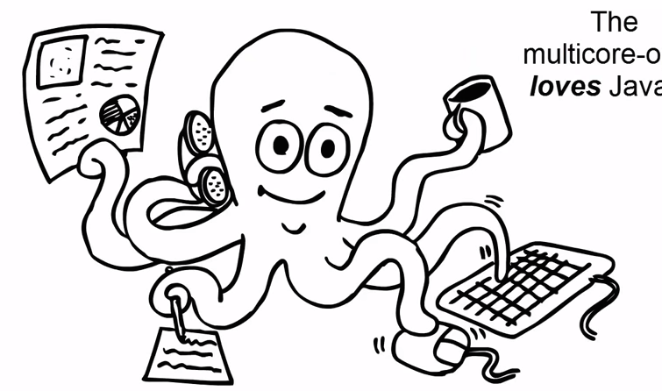
Streams concurrency

Slide 128
Streams concurrency
Streams can also be iterated and processed in a parallel way.
menu.parallelStream().forEach(Dish::heavyCalculation);
The stream will be processed using several threads.
By default, the number of threads is the number of processors.
ParallelStream uses ForkJoin framework behind the scenes.
ParallelStream will not keep the order of the original stream.

Slide 129
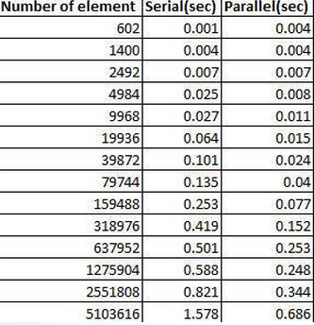
Streams concurrency
Parallel processing should be used only with large scale data:
menu.parallelStream().sorted(Dish::compareTo) Vs menu.stream().sorted(Dish::compareTo)

Slide 130
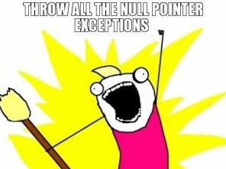
Optionals

Slide 131
Optionals
Defensive Programming: In order to avoid Null Pointer Exceptions we must check for nulls all the time.
All this checks are causing a messy boiler-plate code:
for example: print all the dishes recommended side-dishes
User user = usersMap.get("userName");
if (user != null) {
Adress address = user.getAddress();
if (address != null) {
City city = address.getCity();
if (city != null) {
System.out.println(city.getName());
}
}
}

Slide 132
Optionals
In order to avoid Null Pointer Exceptions we must check for nulls all the time.
All this checks are causing a messy boiler-plate code:
for example: print the user’s city name
User user = usersMap.get("userName");
if (user != null) {
Adress address = user.getAddress();
if (address != null) {
City city = address.getCity();
if (city != null) {
System.out.println(city.getName());
}
}
}
Boilerplate null checks

Slide 133
Optionals
An optional is an object that can either contain a value or be empty.
An Optional can be considered as a Collection with only one element.
Optional interface exposes some nice methods to avoid the boilerplate:
Get return the value if present, throw NoSuchElement if not.
ifPresent apply given method only if not null
OrElse Return current value if present, other wise return given object.
OrElseThrow Return current value if present, Throw a custom exception if not
Optionals are also called Monads in other languages.

Slide 134
Optionals
Print city name (without optional):
City city = getCity(...);
if (city != null) {
System.out.println(city.getName());
}
Print city name (with optional):
Optional<City> city = getCity(...);
city.ifPresent(ct -> System.out.println(ct.getName()));

Slide 135
Optionals
Optionals can be filtered:
city .filter(ct -> c.getSize() > 30000) .ifPresent(ct -> System.out.println(ct.getName()));
If the dish present and has more than 300 calories it will be returns,
If not, NoSuchElement exception will be thrown.

Slide 136
Optionals
Optionals can be mapped:
String cityName = city.map(ct -> ct.getName()).get();
The map (or flatMap) function will return a new optional with the mapped value.

Slide 137
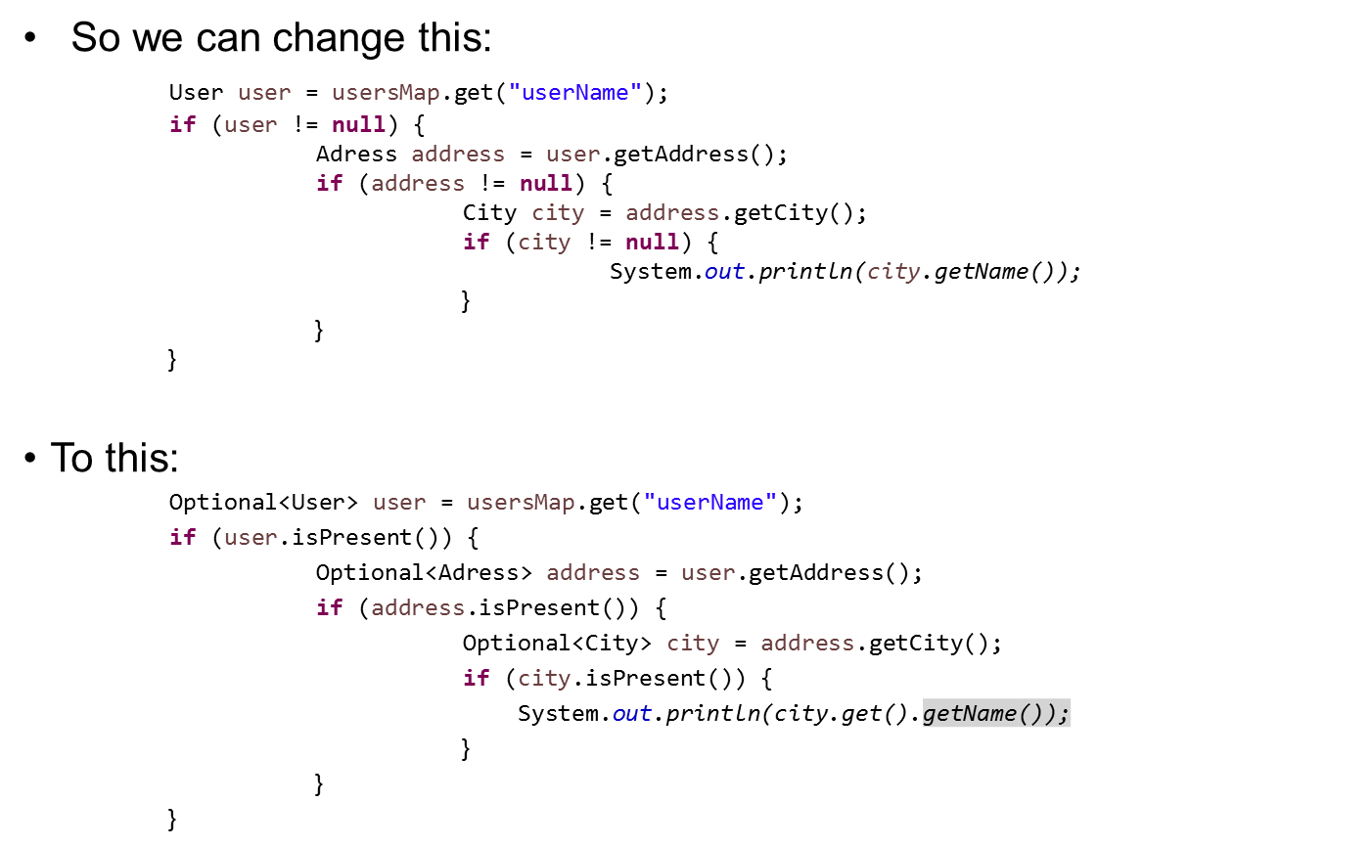
Optionals

Slide 138
Optionals

Slide 139
Optionals
No Null checks!!!

Slide 140
Optionals
No Null checks!!! But is it really better?

Slide 141
Optionals
No!!!
Optionals are built for functional programming.

Slide 142
Optionals
No!!!
Optionals are built for functional programming.
The proper way to get the user’s city name using optionals is this:
Optional<User> user = usersMap.get("userName");
user.map(usr -> usr.getAddress())
.map(address -> address.getCity())
.ifPresent(ct -> System.out.println(ct.getName()));

Slide 143
Optionals
So we can change this: User user = usersMap.get("userName");
if (user != null) {
Adress address = user.getAddress();
if (address != null) {
City city = address.getCity();
if (city != null) {
System.out.println(city.getName());
}
}
}
To this:
Optional<User> user = usersMap.get("userName");
user.map(usr -> usr.getAddress())
.map(address -> address.getCity())
.ifPresent(ct -> System.out.println(ct.getName()));

Slide 144
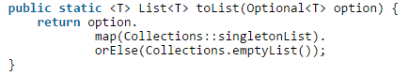
Optionals
Converting Optional<T> to List<T>

Slide 145

Exercise – Max value from files
// file format: Coordinates : [updates:index:company:1425811924774] [BUILD_NUMBER] : [1425811924774] [ENTRIES_UPDATED] : [981]
The need:
Search for all files that begin with “about~index” and fix the max number of “BUILD_NUMBER”

Slide 146
Exercise – Max value from files
Assumptions for simplicity of example:
We have a method to extract the version from the file:
private static String getVersion(File fileResource)

Slide 147
Java 7 Solution
public static String java7Search(String dirToSearch) throws IOException, ConfigurationException { Long highest = 0L; File dir = new File(dirToSearch); if (dir.listFiles()!=null) { for (File file : dir.listFiles()) { if (file.getName().startsWith("about~updates~")) { long current = Long.parseLong(getVersion(file)); if (current > highest) { highest = current; } } } } return highest.toString(); }

Slide 148
Java 8 Solution
public static String java8Search(String dirToSearch) throws IOException, ConfigurationException { Long aLong = Arrays.stream((new File(dirToSearch)).listFiles()) .filter(file -> file.getName().startsWith("about~updates~")) .map(file -> Long.valueOf(getVersion(file))) .max((o1, o2) -> o1 > o2 ? 01 : 02) .orElseGet(() -> 0L); return aLong.toString(); }

Slide 149

Date/Time

Slide 150
Date/Time
Current Java Date/Time API is too complex.
Date/Time classes are not consistently defined:
Java.sql.Date and java.util.Date.
Java.util.date include the time and the java.sql.Date is date only.
Some says that the java.sql classes are redundant and this duplication is a very bad design.
There is a lot of mess with the Date/Time formatters and parsers too: SimpleDateFormat, DateFormat, java.text.*.
Calendar and Date classes are mutable (not thread safe – a big issue in java 8).
There is a very poor internationalization support.

Slide 151
Date/Time
The new Date/Time API principles:
Immutability: Parallelism is a big deal.
Separation of concerns: A clear separation of human readable date/time and machine date/time.
Clarity: The methods are clearly defined. Using them will be exactly the same for all Time classes.
Utility operations: All method come with built-in methods for common operations such as plus, minus, format, parse..
Extendable: ISO calendar but can easily use other calendars.

Slide 152
Date/Time
Java.time.LocalDate
Represent a date with default format of yyyy-MM-dd.
Has a nice methods to get and manipulate dates using a different time zone.
Immutable.

Slide 153
Date/Time
Java.time.LocalDate
Get current date: LocalDate today = LocalDate.now();
Get a date:
LocalDate aDate = LocalDate.of(2014, Month.MARCH, 20);
LocalDate.of(2014, 3, 20);
Get date from the base date (1970): LocalDate dateFrom1970 = LocalDate.ofEpochDay(215);

Slide 154
Date/Time
Java.time.LocalDate
Get the date of the 66th day of 2014:
LocalDate hundredDay2014 = LocalDate.ofYearDay(2014, 66);
Add / subtract LocalDate.now().plusDays(65);
LocalDate.now().minusMonths(67);
LocalDate.now().plusYears(4);
Format date:
LocalDate.now().format(DateTimeFormatter.ofPattern("dd.MM.yyyy"));

Slide 155
Date/Time
Java.time.LocalTime
Represent a time with default format of hh:mm:ss.zzz.
Like local date it has time-zone support and a now method
Java.time.DateTime
Represent a full date time with default format of yyyy-MM-dd-HH:mm:ss.zzz.
Has factory method that gets LocalTime and LocalDate.
java.time.Instant
Represent a machine time (unix template). For example: 2014-08-03T20:54:16:07.472Z

Slide 156
Date/Time
Some extras:
Period calculation:
LocalDate today = LocalDate.now();
LocalDate aDate = LocalDate.of(2014, Month.MARCH, 20);
Period period = aDate.until(today);
period.getDays();
Old date/time API support:
Calendar.getInstance().toInstant();
Calendar.getInstance().getTime().toInstant();

Slide 157

No PermGen

Slide 158
No PermGen
The Permanent Generation is a memory section that stores loaded classes info such as (names and structure).
Running out of PermGen space is inevitable. We are all familiar with java.lang.OutOfMemoryError: PermGen exception.
PermGen size can be changed using the flags: PermSize and MaxPermSize
In Java 8, the PermGen is completely removed.
Java 8 introduces a new memory space: the Metaspace.

Slide 159
No PermGen
Metaspace:
Grow automatically by default.
Growth will be linear.
Metaspace data will be garbage collected.
New two flags:
MetaspaceSize: Define larger metaspaces memory.
MaxMetaspaceSize: Define when the GC will be invoked.

Slide 160
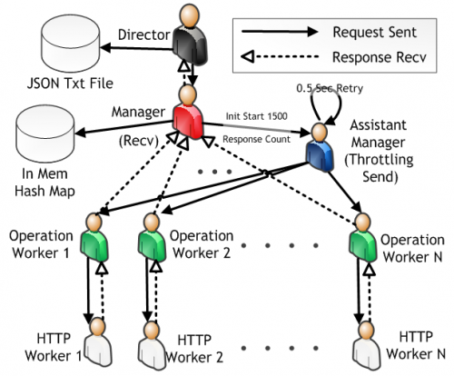
Concurrency

Slide 161
LongAdder, DoubleAdder
AtomicInteger – this set of classes uses CAS (compare-and-swap) processor instructions to update the value of the counter. Sounds great, doesn’t it? Well, yes and no. This works well as it utilizes a direct machine code instruction to set the value with minimum effect on the execution of other threads. The downside is that if it fails to set the value due to a race with another thread, it has to try again. Under high contention this can turn into a spin lock, where the thread has to continuously try and set the value in an infinite loop, until it succeeds.
Java 8 Adders – From a usage perspective it’s very similar to an AtomicInteger. Simply create a LongAdder and use intValue() and add() to get / set the value. The magic happens behind the scenes.
What this class does is when a straight CAS fails due to contention, it stores the delta in an internal cell object allocated for that thread. It then adds the value of pending cells to the sum when intValue() is called. This reduces the need to go back and CAS or block other threads.

Slide 162
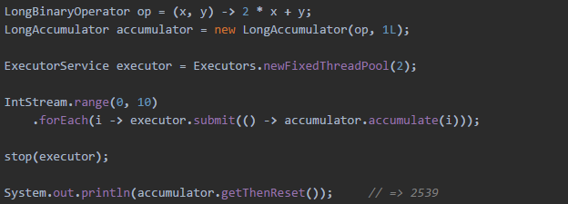
LongAccumulator
Class LongAdder provides analogs of the functionality of this class for the common special case of maintaining counts and sums. The call new LongAdder() is equivalent to new LongAccumulator((x, y) -> x + y, 0L.

Slide 163
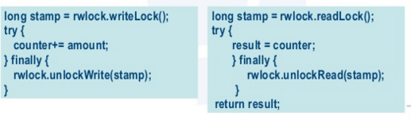
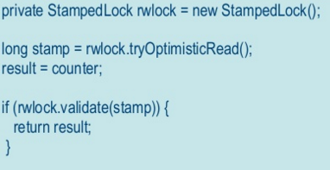
StampedLock
ReadWriteLocks You can specify which threads block everyone else (writers), and which ones play well with others for consuming content (readers)
Optimistic locking. The most important piece in terms of new capabilities for this lock is the new Optimistic locking mode. Research and practical experience show that read operations are for the most part not contended with write operations. Asa result, acquiring a full-blown read lock may prove to be overkill. A better approach may be to go ahead and perform the read, and at the end of it see whether the value has been actually modified in the meanwhile. If that was the case you can retry the read, or upgrade to a heavier lock.

Slide 164
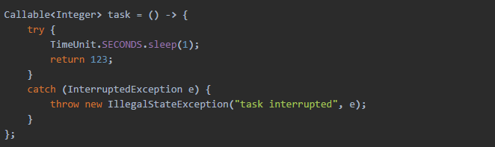
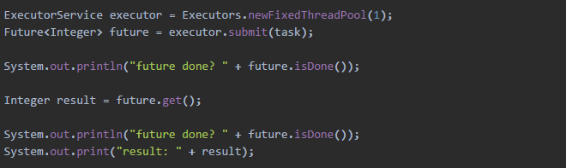
Concurrency

Slide 165
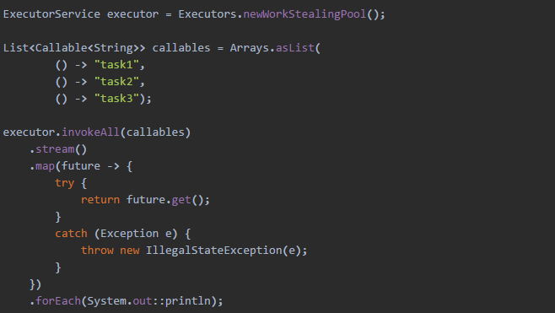
Concurrency - streams

Slide 166
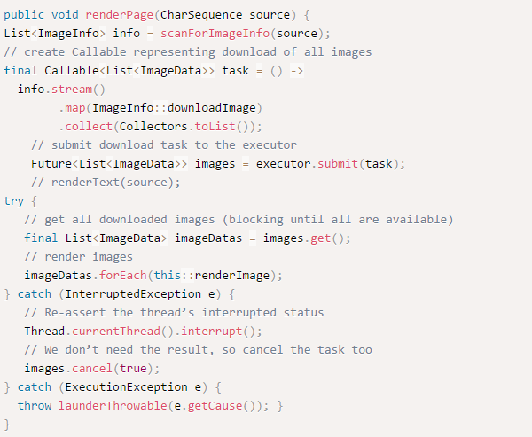
Concurrency – Single List

Slide 167
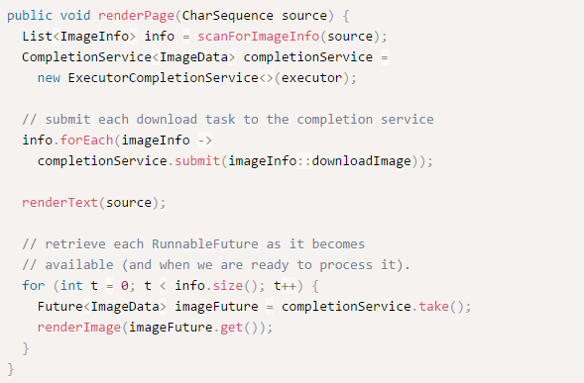
Concurrency – Parallel task

Slide 168
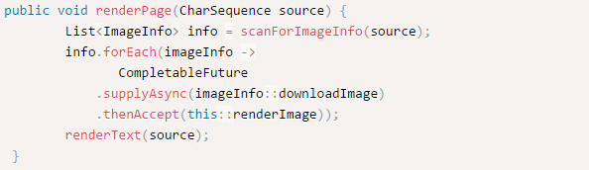
CompletableFuture

Slide 169
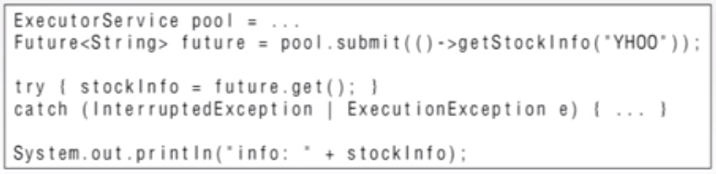
CompletableFuture
Java 5

Slide 170
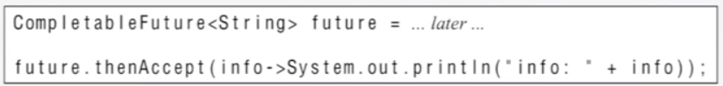
CompletableFuture

Slide 171
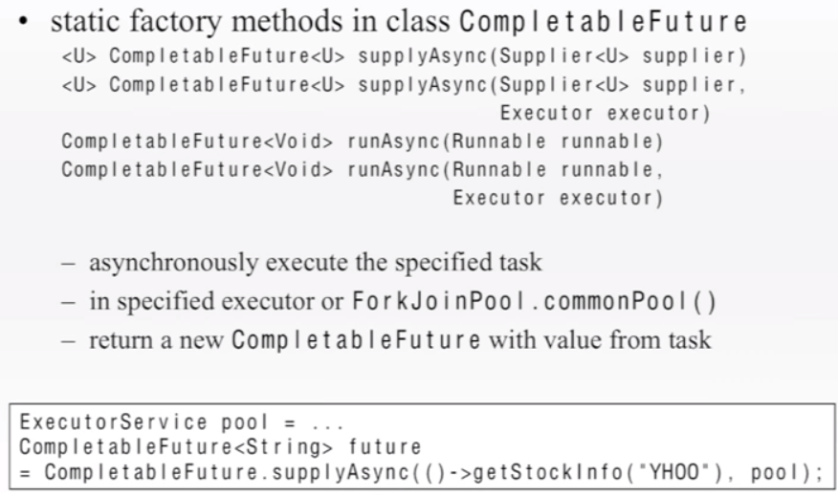
CompletableFuture

Slide 172
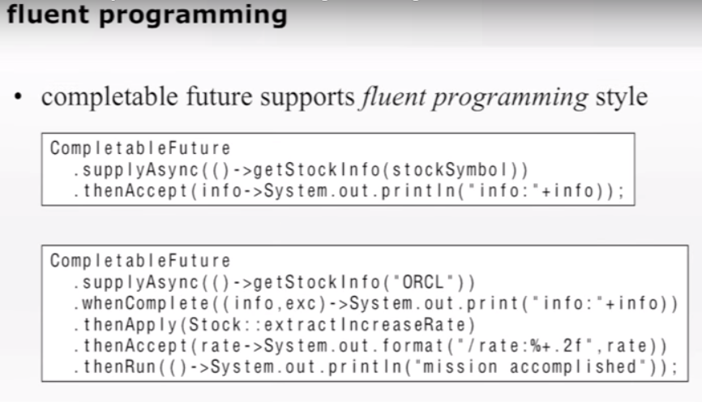
CompletableFuture

Slide 173
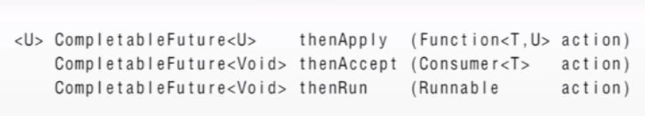
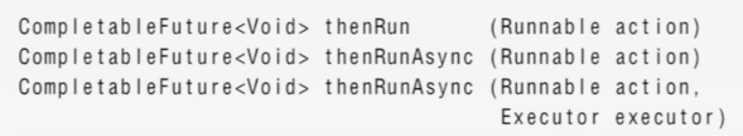
CompletableFuture

Slide 174
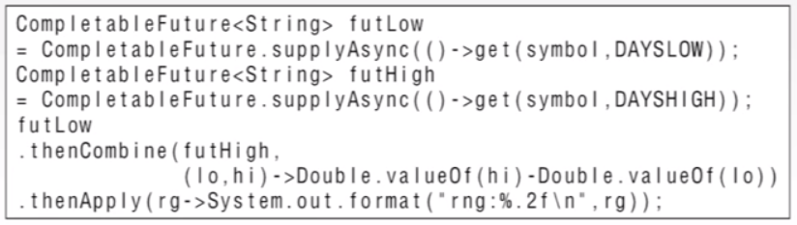
CompletableFuture

Slide 175

THANK YOU
Chaim Turkel
Email: chaim@tikalk.com

Slide 176
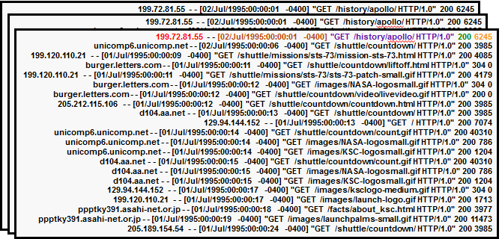

Exercise – Apache logs analysis

Slide 177
Exercise – Apache logs analysis
There are multiple log files in the logs folder.
Log files are very big and cannot be loaded to the memory.
Our job is to analyze the logs.
Do not use try/catch. Just throw exceptions.

Slide 178
Exercise – Apache logs analysis
10. Find how many GET request received
public Long HowManyGets() {
Function<LogEntry, String> parseMethod = le -> {
String request = le.getRequest();
return request.substring(0, request.indexOf(' '));
};
return streamLogs()
.filter(le -> parseMethod.apply(le).equals("GET"))
.count();
}

Slide 179
Exercise – Apache logs analysis
Project:
LogEntry.java:
An entity class to represent a log entry. It has parse method to generate a LogEntry out of a line according to the log pattern.
LogAnalyiticService: Logics class (which we need to implement).
LogAnaltyicesServiceTest: Test class.

Slide 180
Exercise – Apache logs analysis
Count the lines of a log file.
be sure to load only “.log” files.
use Files.list(Paths.get(location)) to get a stream to the files.
public Long findNumberOfLinesInFirstLog() throws IOException {
}

Slide 181
Exercise – Apache logs analysis
Reminder!
Stream lines of all files of “txt“ type
Files.list(Paths.get(“/filesLocation”))
.filter(p -> p.toString().endsWith(“txt”))
.flatMap(Files.lines(path, charset);
.map(this::parse);

Slide 182
Exercise – Apache logs analysis
Count the lines of a log file.
be sure to load only “.log” files.
use Files.list(Paths.get(location)) to get a stream to the files.
public Long findNumberOfLinesInFirstLog() throws IOException {
return Files.list(Paths.get(loggingDir))
.filter(p -> p.toString().endsWith(LOG_EXT))
.limit(1)
.flatMap(this::getLines)
.count();
}

Slide 183
Exercise – Apache logs analysis
Stream all log entries from all logs.
Use LogEntry.parse() method.
If parse fails it returns null – don’t add it to the final stream.
For your convinience, you can catch Exception and throw RuntimeException.
public Stream<LogEntry> streamLogs() {
try {
} catch (Exception e) {
throw new RuntimeException();
}
}

Slide 184
Exercise – Apache logs analysis
Stream all log entries from all logs.
Use LogEntry.parse() method.
If parse fails it returns null – don’t add it to the final stream.
For your convinience, you can catch Exception and throw RuntimeException.
public Stream<LogEntry> streamLogs() {
try {
return Files.list(Paths.get(loggingDir))
.filter(p -> p.toString().endsWith(LOG_EXT))
.flatMap(this::getLines)
.map(LogEntry::parse)
.filter(le -> le != null);
} catch (Exception e) {
throw new RuntimeException();
}
}

Slide 185
Exercise – Apache logs analysis
3. Find all errors.
Use streamLogs() method.
Errors has response code 500 or greater.
public List<LogEntry> findAllErrorLogs() {
}

Slide 186
Exercise – Apache logs analysis
3. Find all errors.
Use streamLogs() method.
Errors has response code 500 or greater.
public List<LogEntry> findAllErrorLogs() {
return streamLogs()
.filter((le) -> le.getResponse() >= 500)
.collect(toList());
}

Slide 187
Exercise – Apache logs analysis
4. Get last 10 errors.
Logs are not sorted.
Last 10 Errors can be listed in one file or maybe in all of them. (Use the the logEntry dateTime)
public List<LogEntry> findLast10ErrorLogs() {
}

Slide 188
Exercise – Apache logs analysis
4. Get last 10 errors.
Logs are not sorted.
Last 10 Errors can be listed in one file or maybe in all of them. (Use the the logEntry dateTime)
public List<LogEntry> findLast10ErrorLogs() {
return streamLogs()
.filter((le) -> le.getResponse() >= 500)
.sorted((le1, le2) -> le2.getDateTime().compareTo(le1.getDateTime()))
.limit(10)
.collect(toList());
}

Slide 189
Exercise – Apache logs analysis
4. Get last 10 errors.
Logs are not sorted.
Last 10 Errors can be listed in one file or maybe in all of them.
public List<LogEntry> findLast10ErrorLogs() {
return streamLogs()
.filter((le) -> le.getResponse() >= 500)
.sorted(Comparator.comparing(LogEntry::getDateTime).reversed()) .limit(10)
.collect(toList());
}

Slide 190
Exercise – Apache logs analysis
4. Get last 10 errors.
Logs are not sorted.
Last 10 Errors can be listed in one file or maybe in all of them.
public List<LogEntry> findLast10ErrorLogs() {
return streamLogs()
.filter((le) -> le.getResponse() >= 500)
.sorted(Comparator.comparing(LogEntry::getDateTime).reversed()) .limit(10)
.collect(toList());
{
Pre-created comparing function

Slide 191
Exercise – Apache logs analysis
5. Were there any empty responses? empty response -> no bytes sent.
Public boolean wereThereEmptyResponses() {
}

Slide 192
Exercise – Apache logs analysis
5. Were there any empty responses? empty response -> no bytes sent.
Public boolean wereThereEmptyResponses() {
return streamLogs().anyMatch( le -> le.getBytesSent() == 0);
}

Slide 193
Exercise – Apache logs analysis
6. Were there any requests after 1995?
Public boolean wereThereEmptyResponses() {
}

Slide 194
Exercise – Apache logs analysis
6. Were there any requests after 1995?
Public boolean wereThereEmptyResponses() {
return streamLogs().anyMatch( le -> le.getDate.getYear() > 1995);
}

Slide 195
Exercise – Apache logs analysis
7. Create a method to check if there any entries that fits a condition.
Public boolean wereThere(Predicate<LogEntry> predicate) {
}

Slide 196
Exercise – Apache logs analysis
7. Create a method to check if there any entries that fits some condition.
Public boolean wereThere(Predicate<LogEntry> predicate) {
return streamLogs().anyMatch(predicate);
}

Slide 197
Exercise – Apache logs analysis
8. Map all log entries by dates.
public Map<LocalDate, List<LogEntry>> mapByDates() {
}

Slide 198
Exercise – Apache logs analysis
8. Map all log entries by dates.
public Map<LocalDate, List<LogEntry>> mapByDates() {
return streamLogs()
.collect(groupingBy(LogEntry::getDate));
}

Slide 199
Exercise – Apache logs analysis
9. Find how many bytes totally were sent
public Optional<Integer> findHowManyBytesSent() {
}

Slide 200
Exercise – Apache logs analysis
9. Find how many bytes totally were sent
public Optional<Integer> findHowManyBytesSent() {
return streamLogs()
.map(le -> le.getByteSent())
.reduce((sum, bytes) -> sum += bytes); }

Slide 201
Exercise – Apache logs analysis
9. Find how many bytes totally were sent
public Optional<Integer> findHowManyBytesSent() {
return streamLogs()
.map(le -> le.getByteSent())
.reduce((sum, bytes) -> sum += bytes); } public Optional<Integer> findHowManyBytesSent() {
return streamLogs()
.map(LogEntry::getByteSent)
.reduce((sum, bytes) -> sum += bytes); }
Using a reference to the getter method is more elegant

Slide 202
Exercise – Apache logs analysis
10. Find how many GET request received
public Long HowManyGets() {
}

Slide 203
Exercise – Apache logs analysis
10. Find how many GET request received
public Long HowManyGets() {
Function<LogEntry, String> parseMethod = le -> {
String request = le.getRequest();
return request.substring(0, request.indexOf(' '));
};
}

Slide 204
Exercise – Apache logs analysis
10. Find how many GET request received
public Long HowManyGets() {
Function<LogEntry, String> parseMethod = le -> {
String request = le.getRequest();
return request.substring(0, request.indexOf(' '));
};
}
Local Function - not a method

